Slide 1

Examination System
Mosub Gamal
Abdallah Gamal
Omar Khaled
Mohamed Rabea
Mostafa Gheda
Marwa Mohamed

Slide 2
Project Idea
Examination system to manage exam process and student grades in each course and assign instructors to courses.
There are three users (Manager, Instructor, Student), each of them has their permissions.

Slide 3
DEMO

Slide 4
Tools & Technologies
Microsoft SQL Server
Visual Studio
SSIS
SSAS
SSRS
Power Bi
Python

Slide 5
Sql

Slide 6
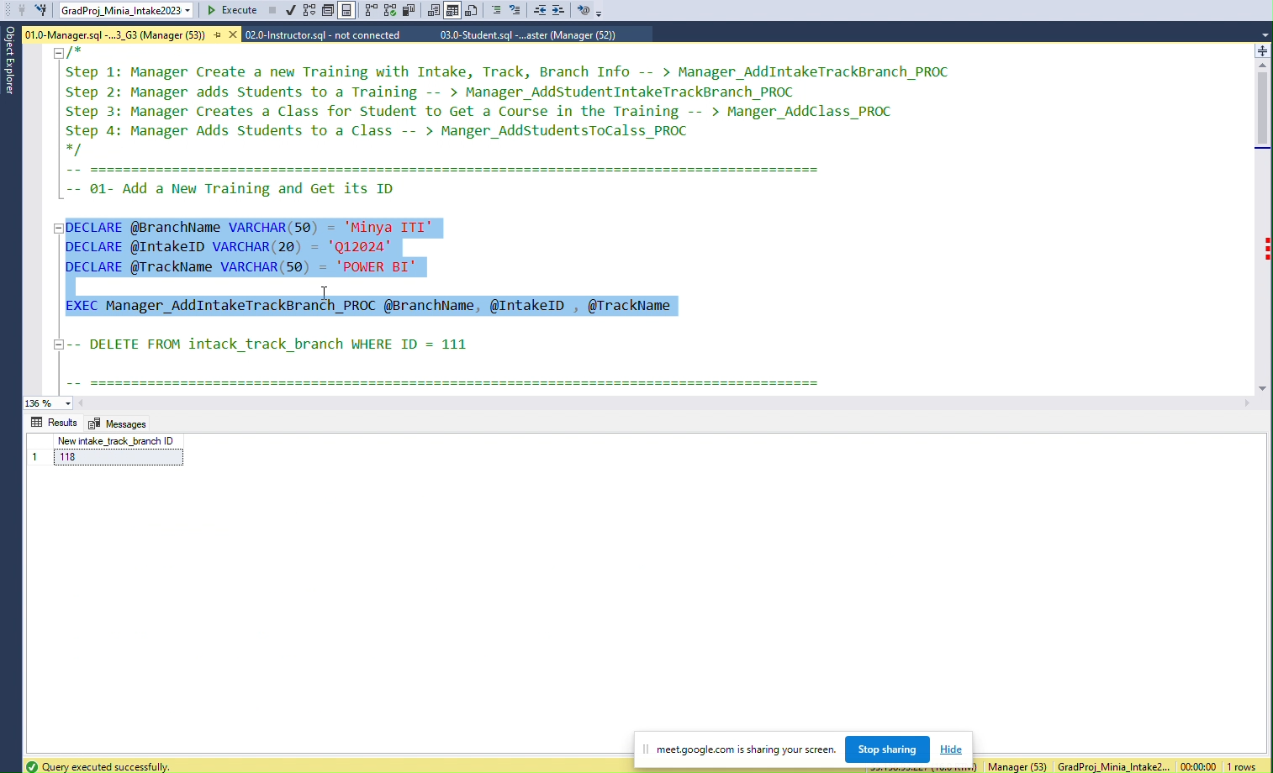
Manager Add Training

Slide 7
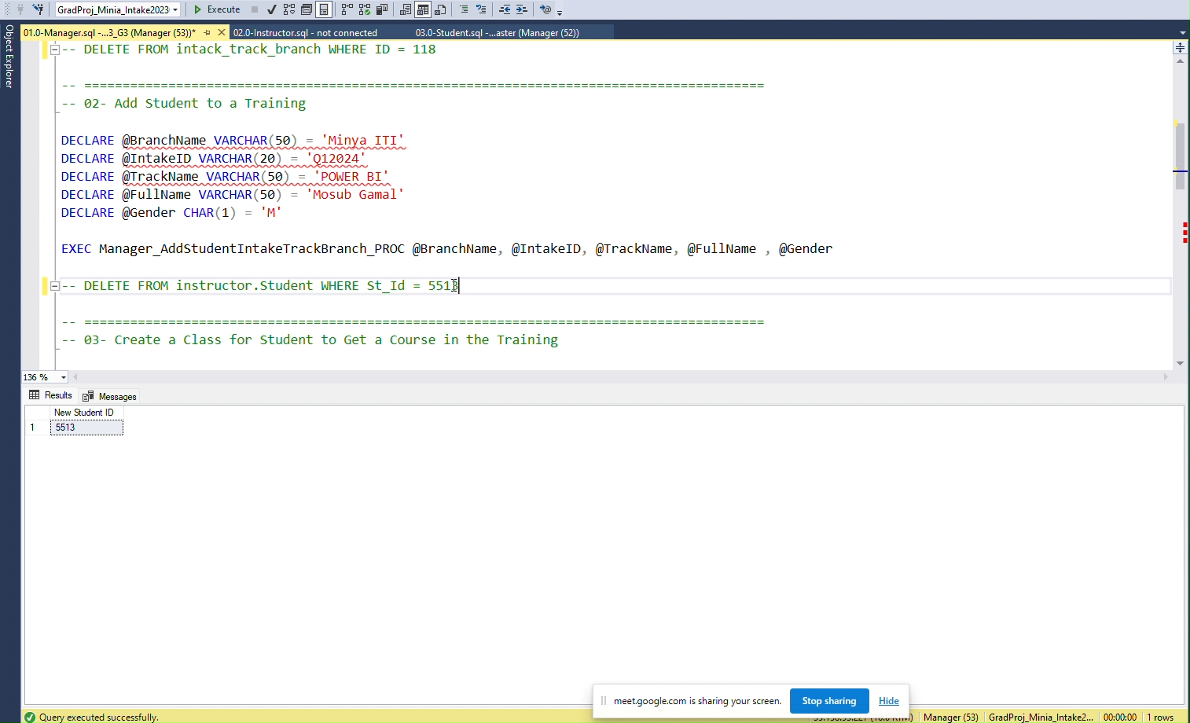
Manger Add Student to Training

Slide 8
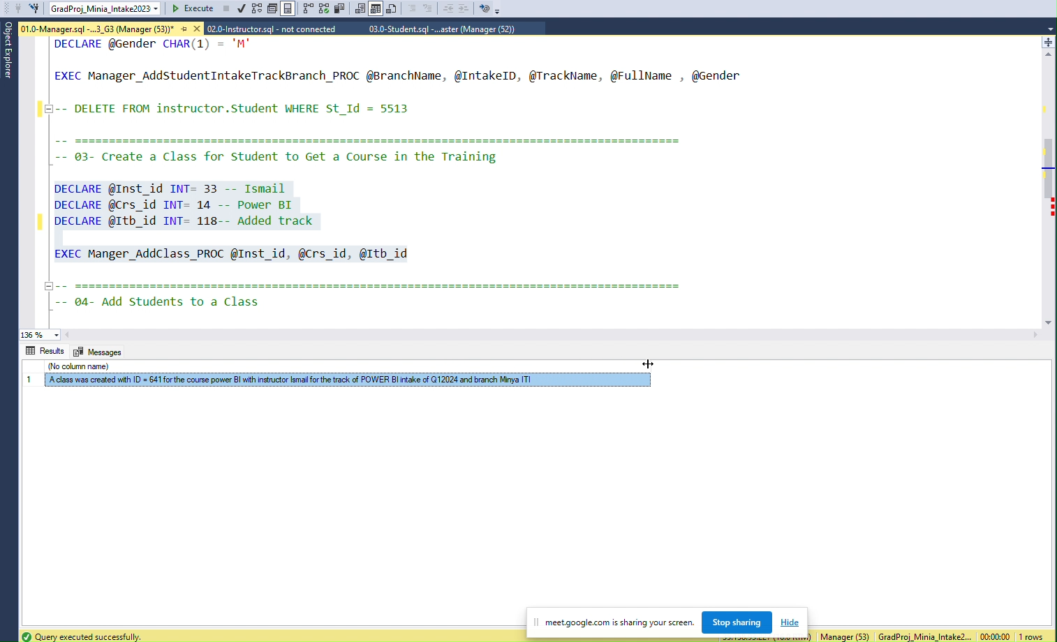
Manager Create Class

Slide 9
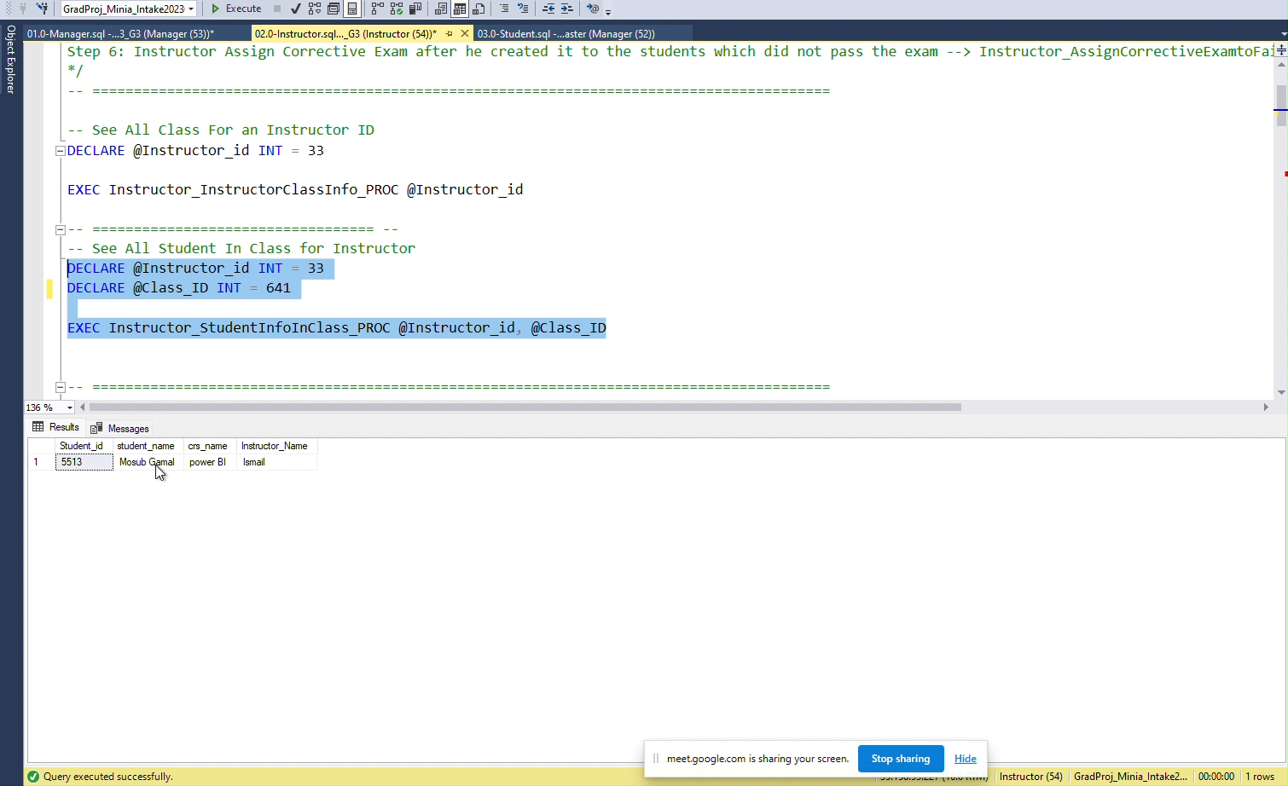
Instructor See all student in a Class

Slide 10
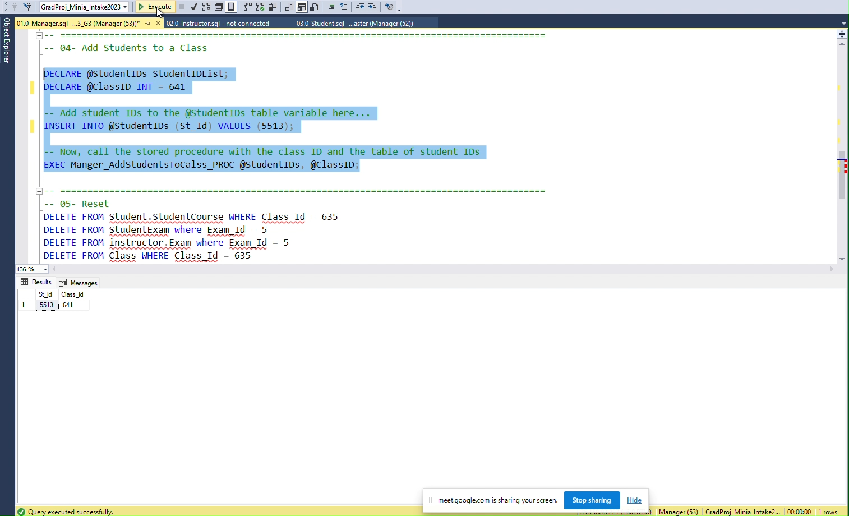
Add Student to A Class

Slide 11
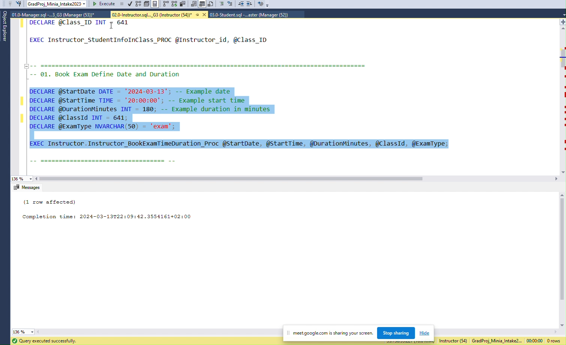
Instructor Book An Exam

Slide 12
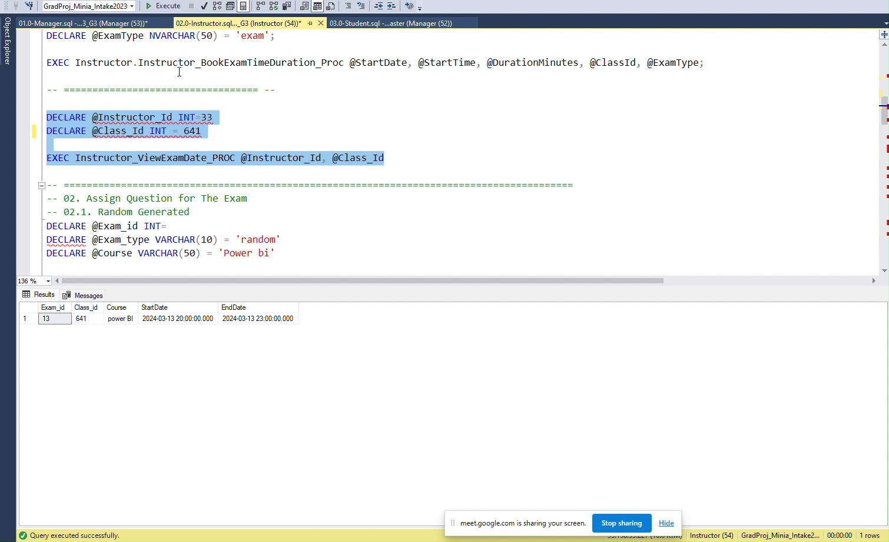
Instructor Check Exam

Slide 13
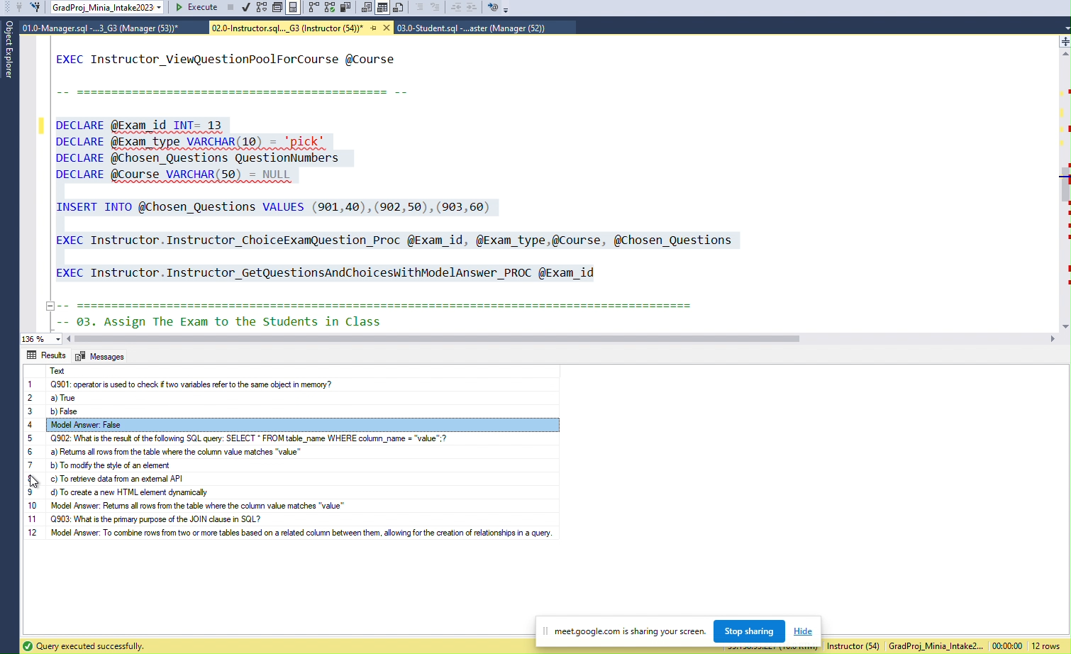
Instructor Pick Exam Questions

Slide 14
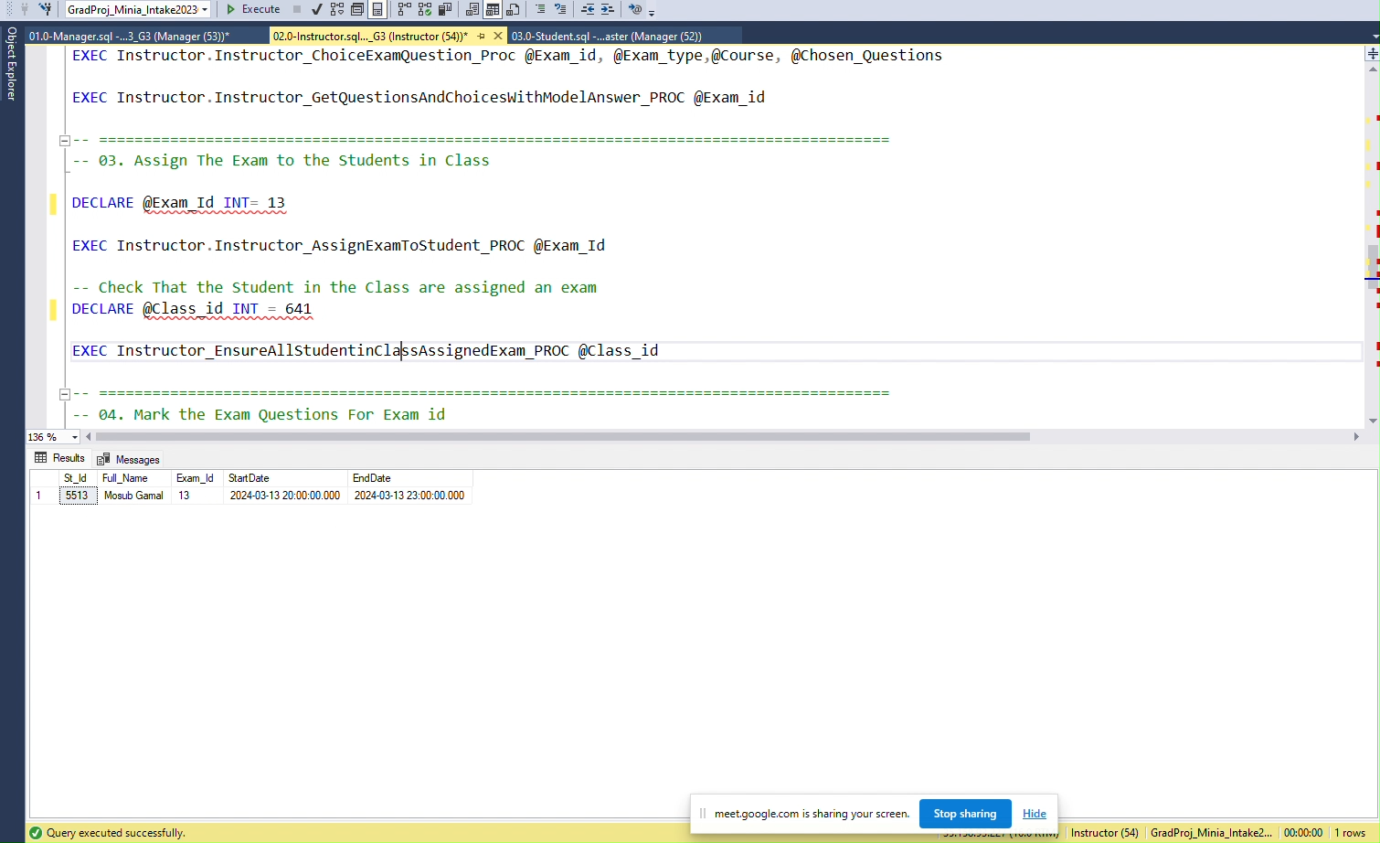
Instructor Assign Student to a Exam

Slide 15
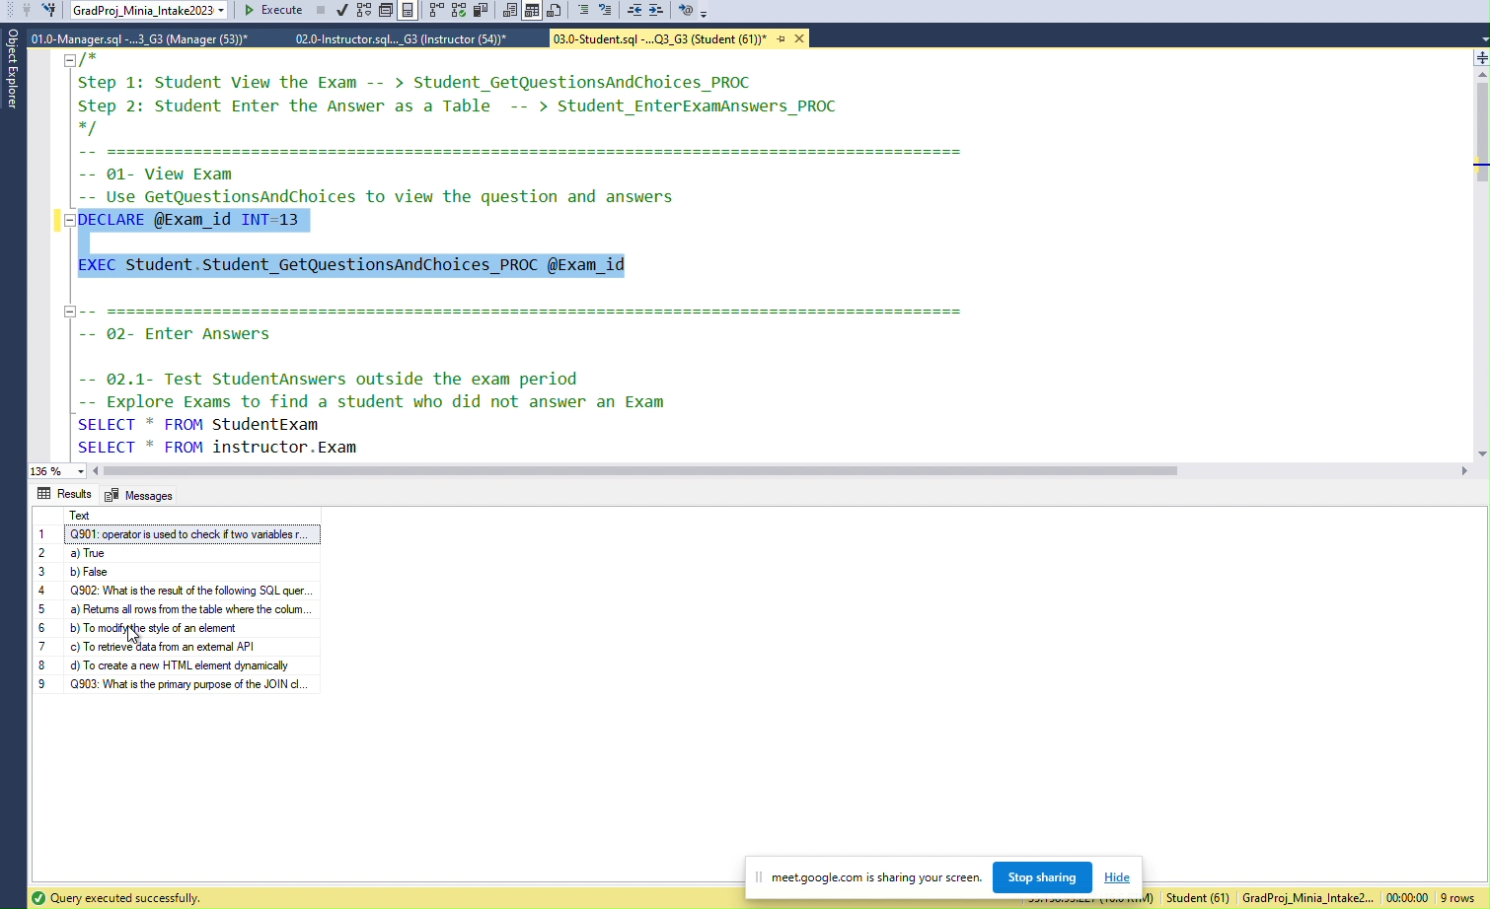
Student See Exam

Slide 16
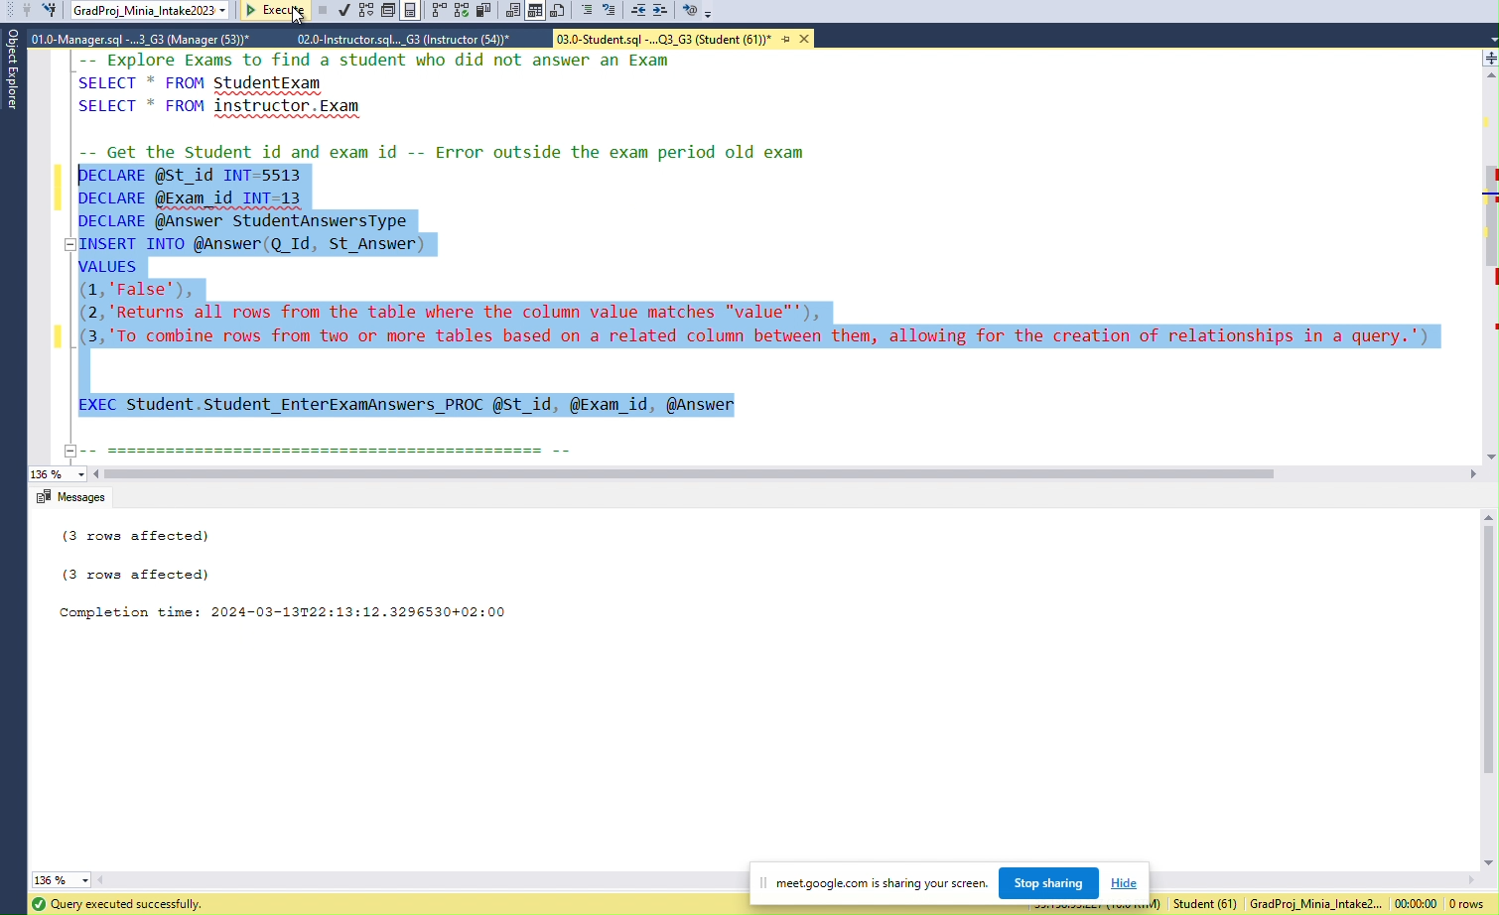
Student Enters Answers

Slide 17
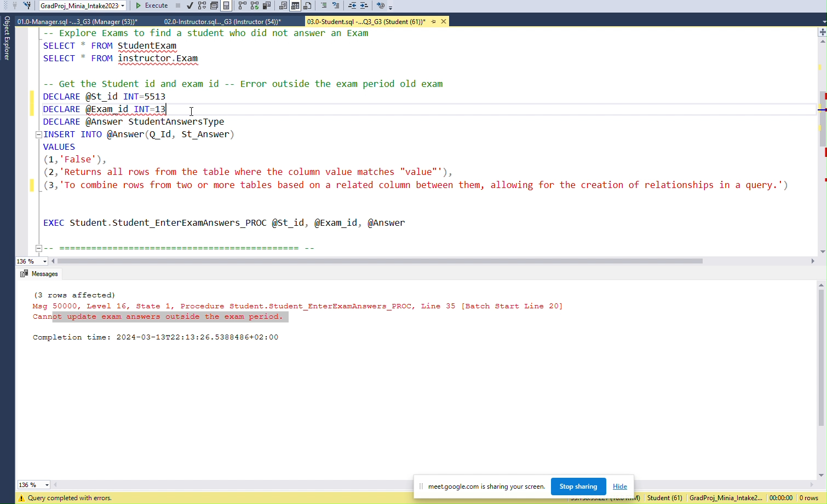
Student Enters Answer outside exam Period

Slide 18
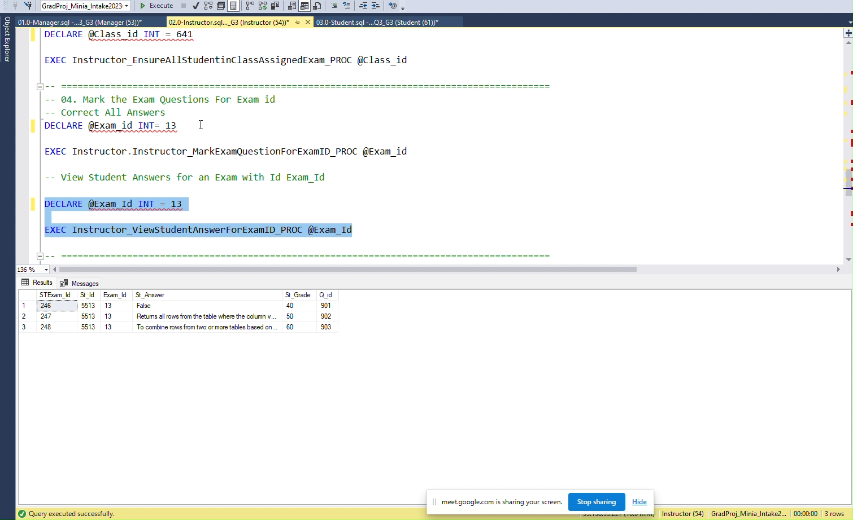
Instructor Mark Each Question

Slide 19
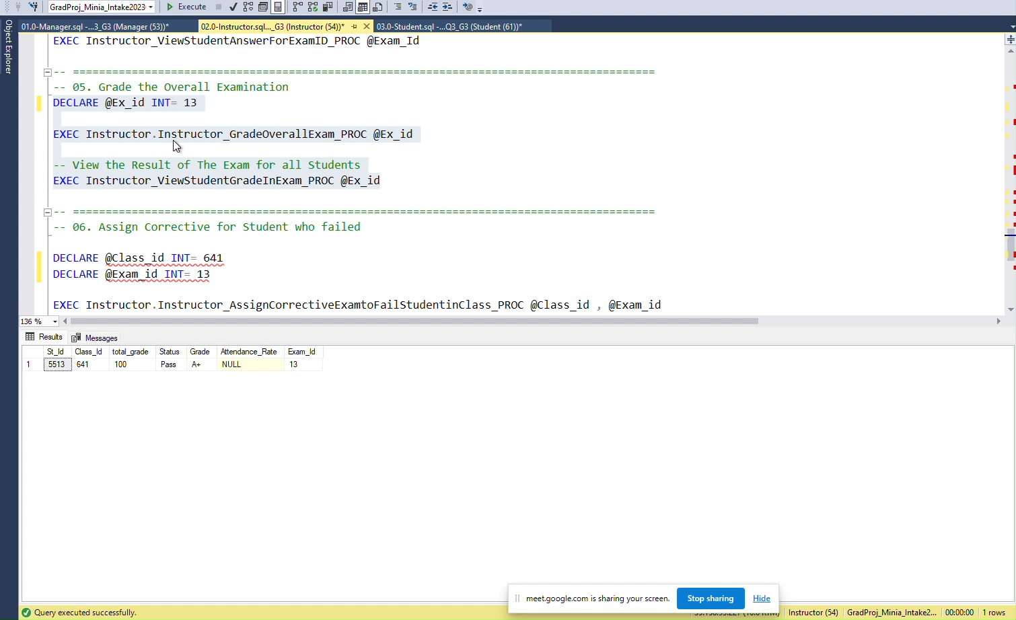
Instructor Grade All Exam

Slide 20
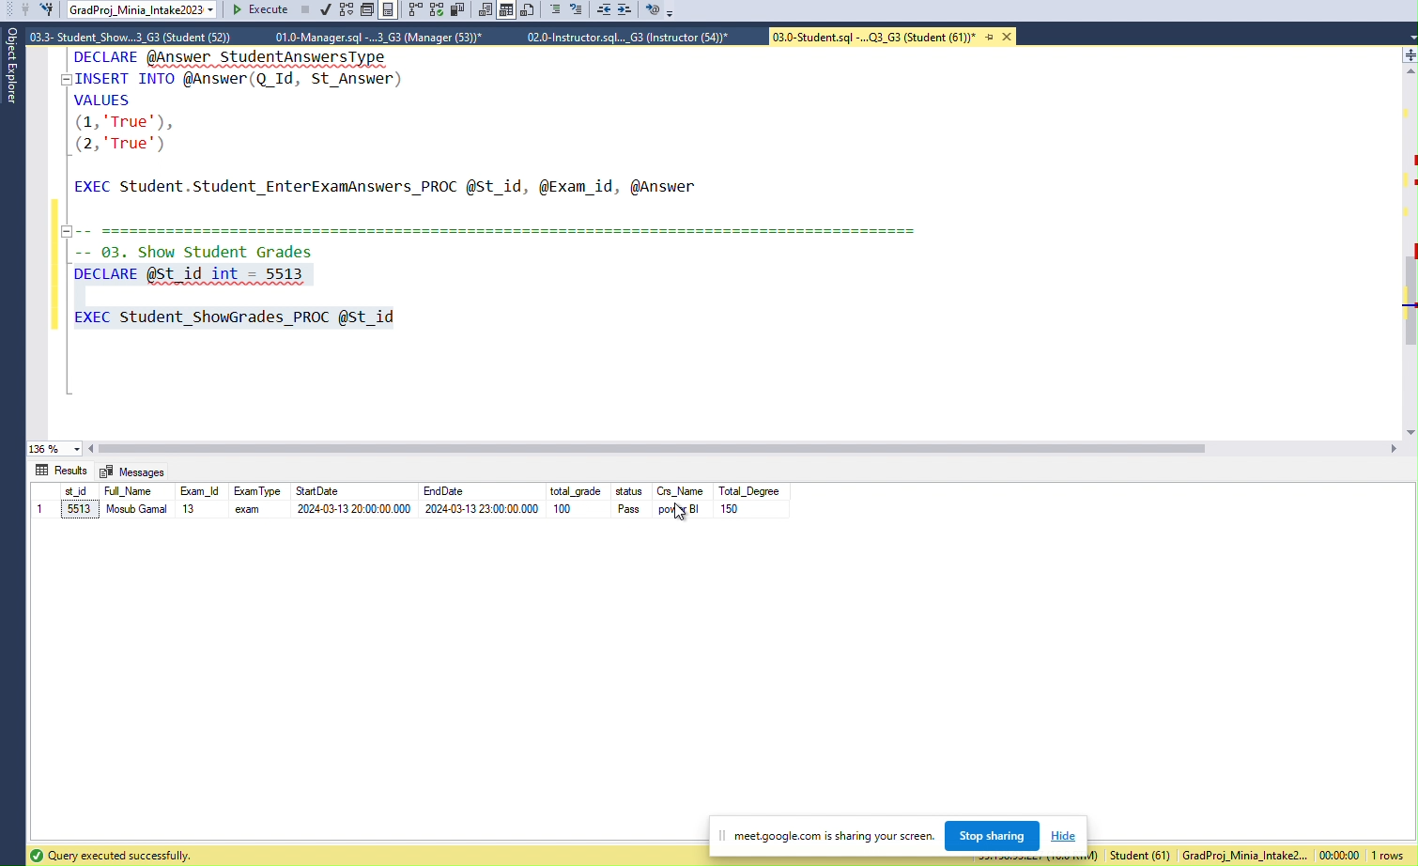
Student Show Answers

Slide 21
ERD

Slide 22
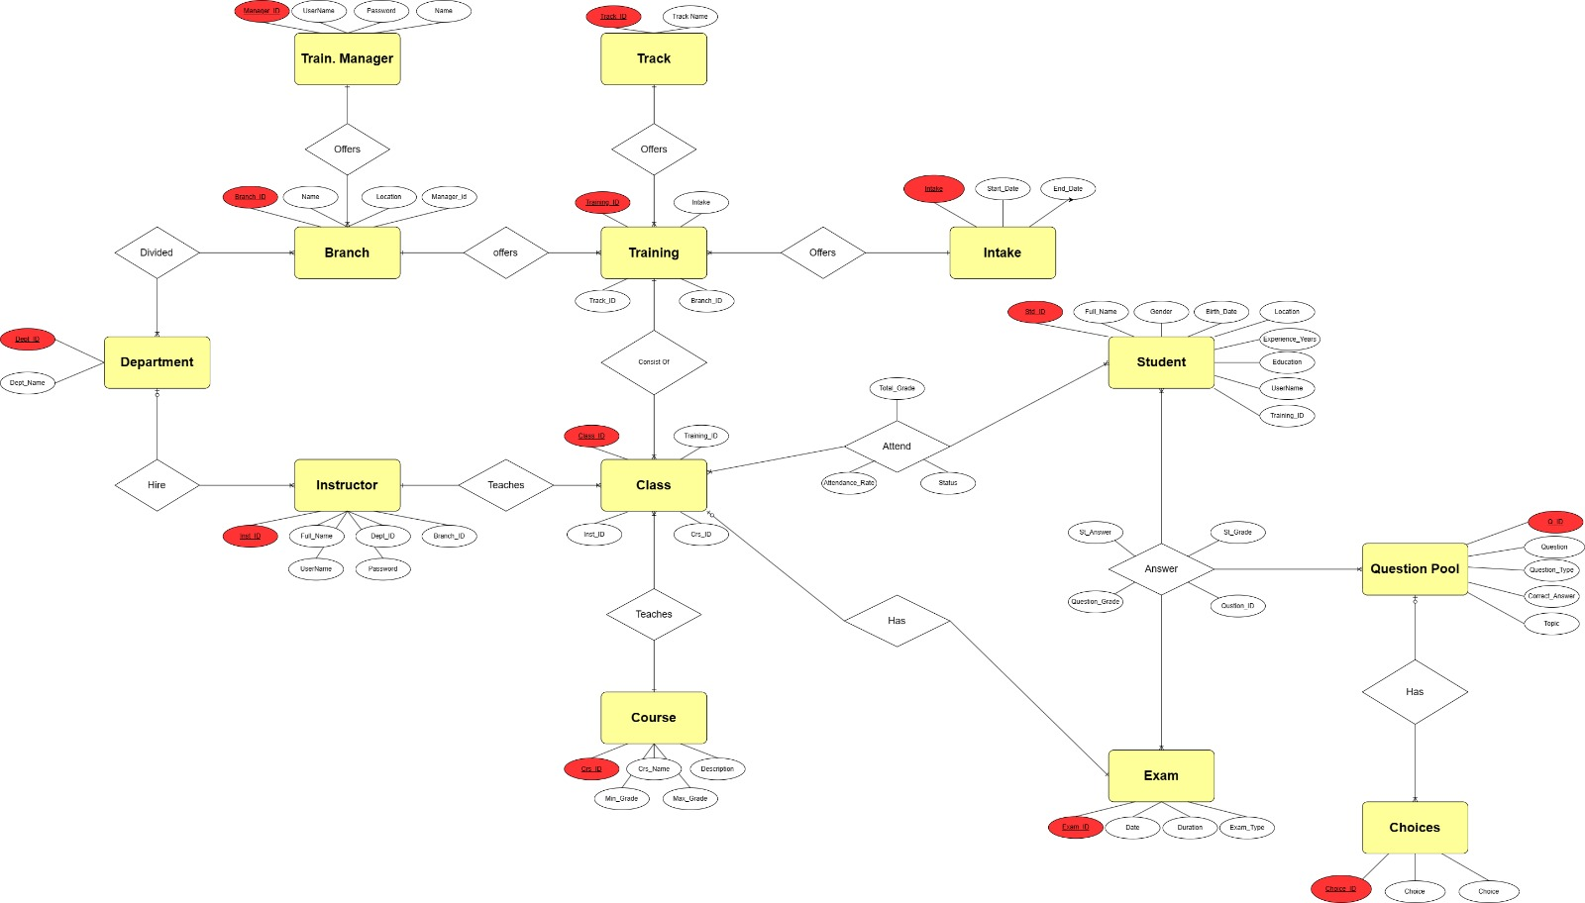
ERD

Slide 23
Data Warehouse

Slide 24
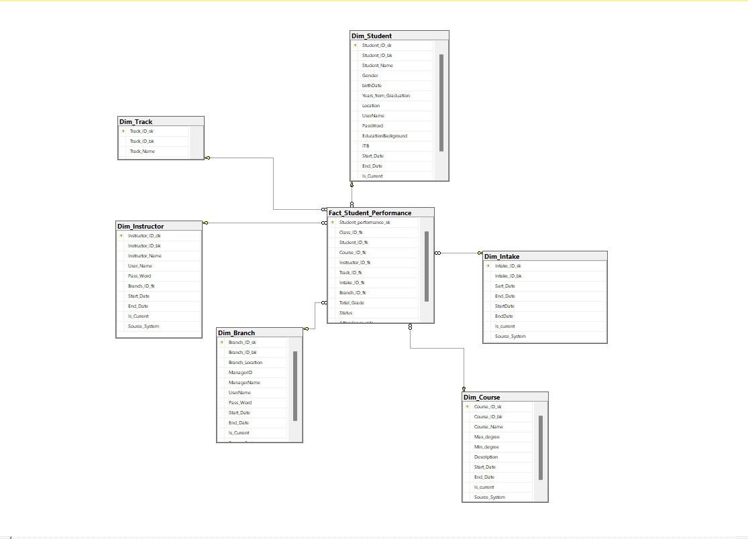

Slide 25
SSIS

Slide 26
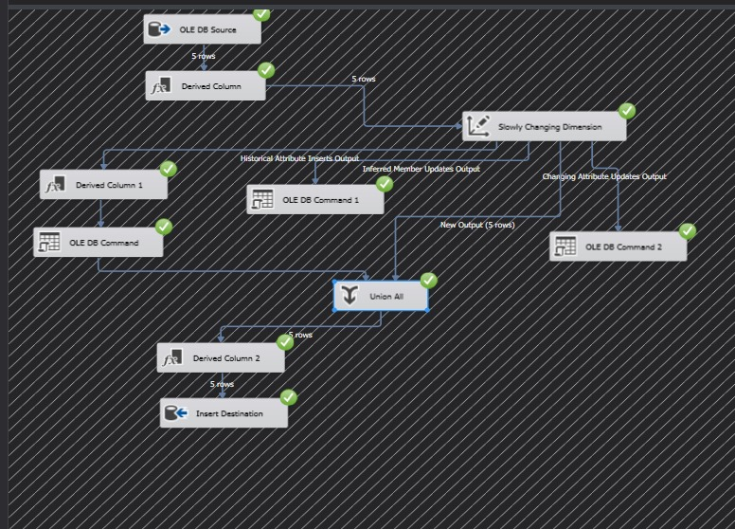
Branch

Slide 27
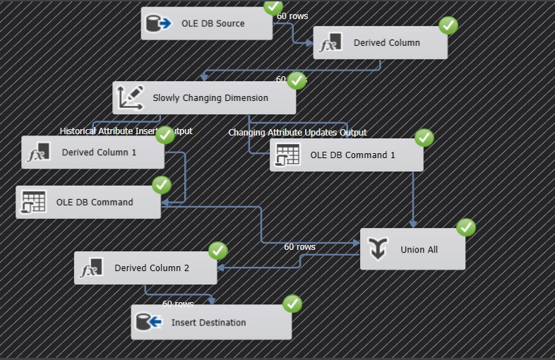
Course

Slide 28
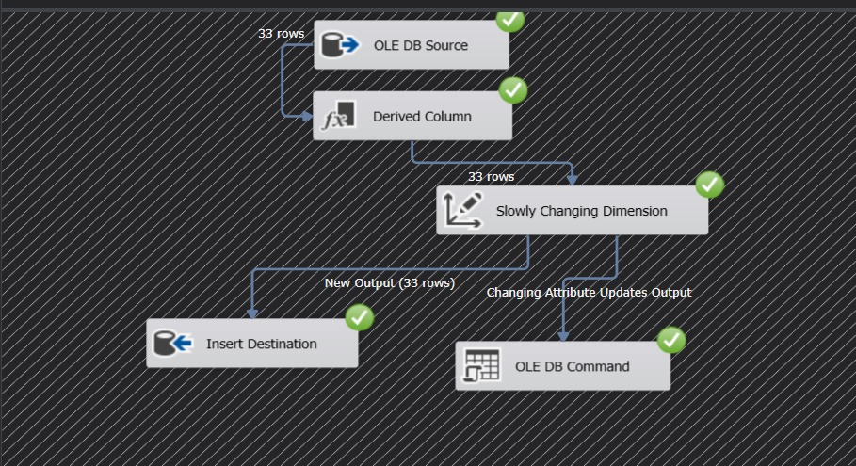
Instructor

Slide 29
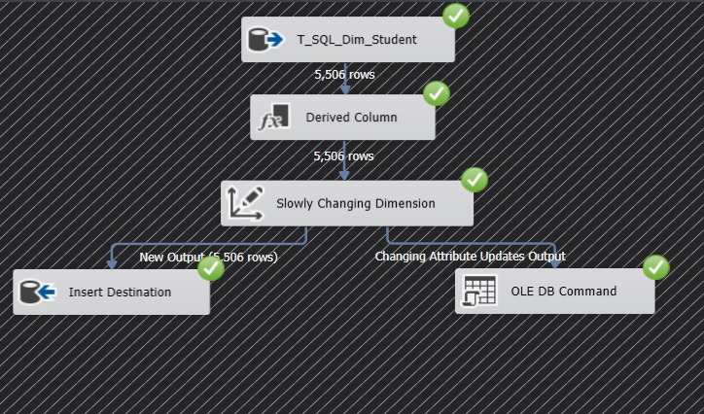
Student

Slide 30
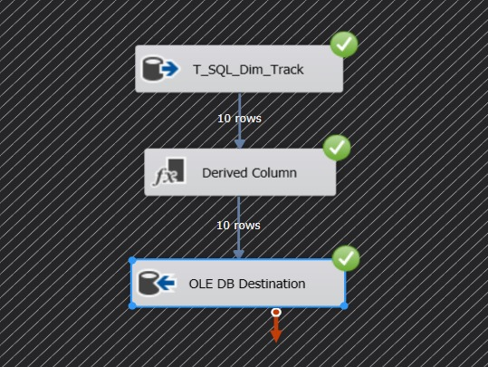
Track

Slide 31
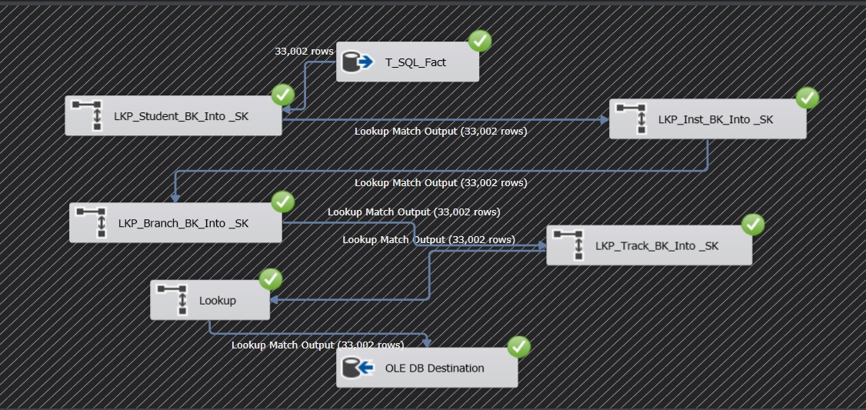
Fact

Slide 32
SSAS

Slide 33
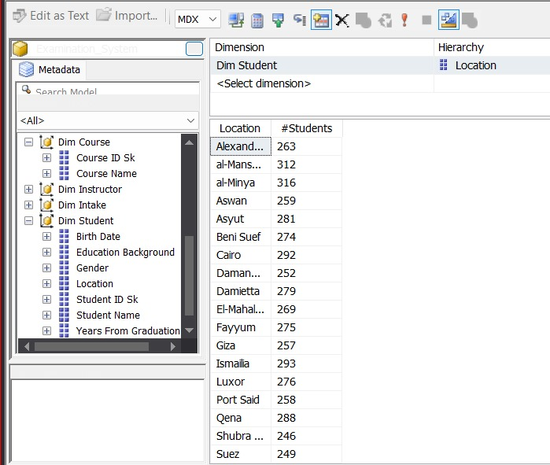

Slide 34
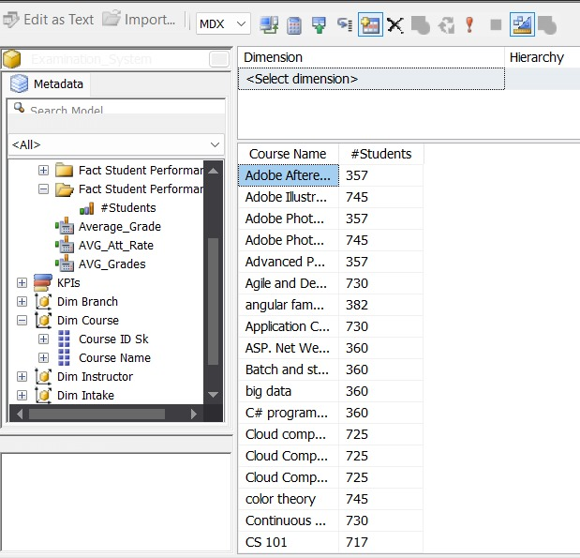

Slide 35
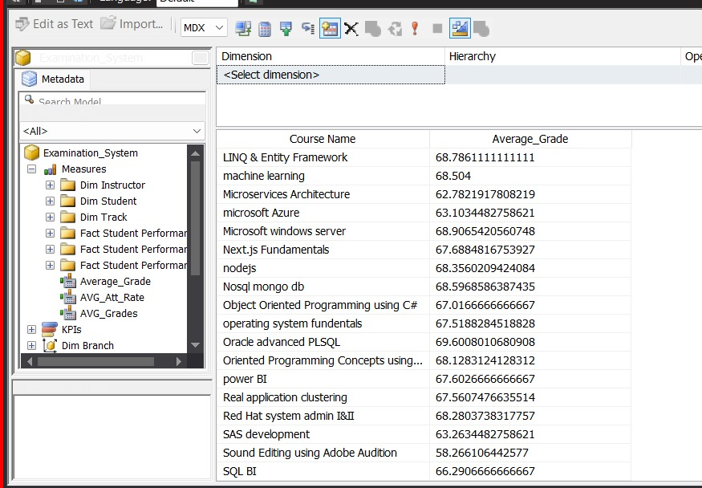

Slide 36
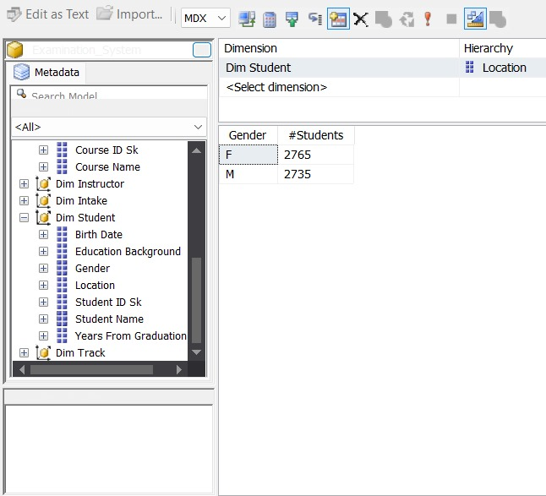

Slide 37
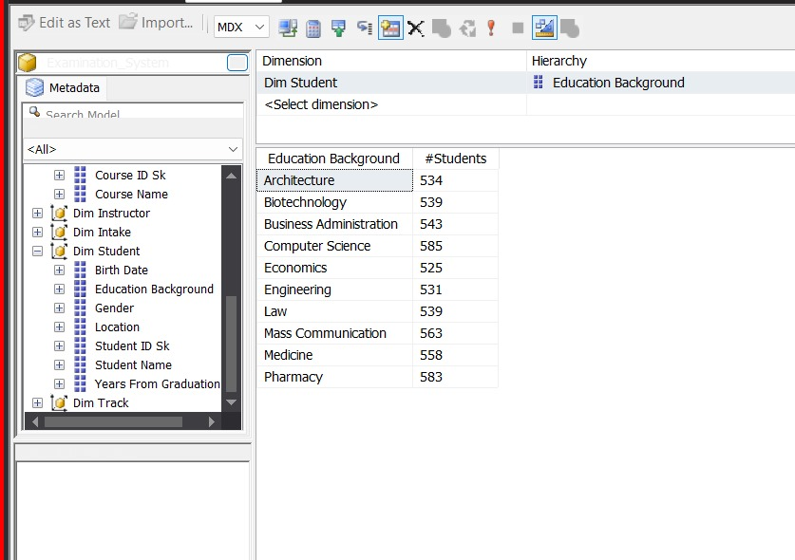

Slide 38
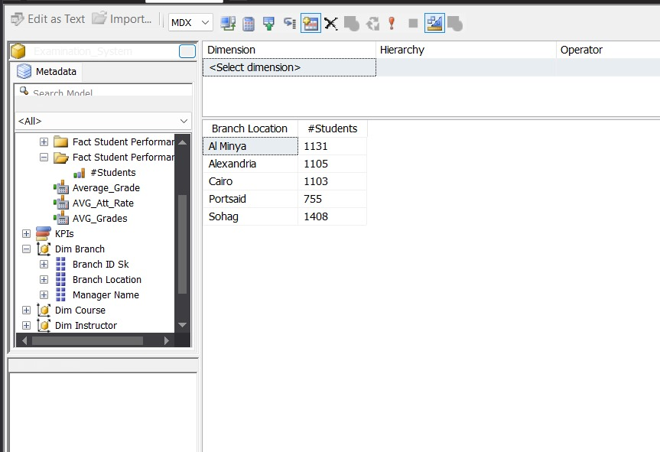

Slide 39
SSRS

Slide 40
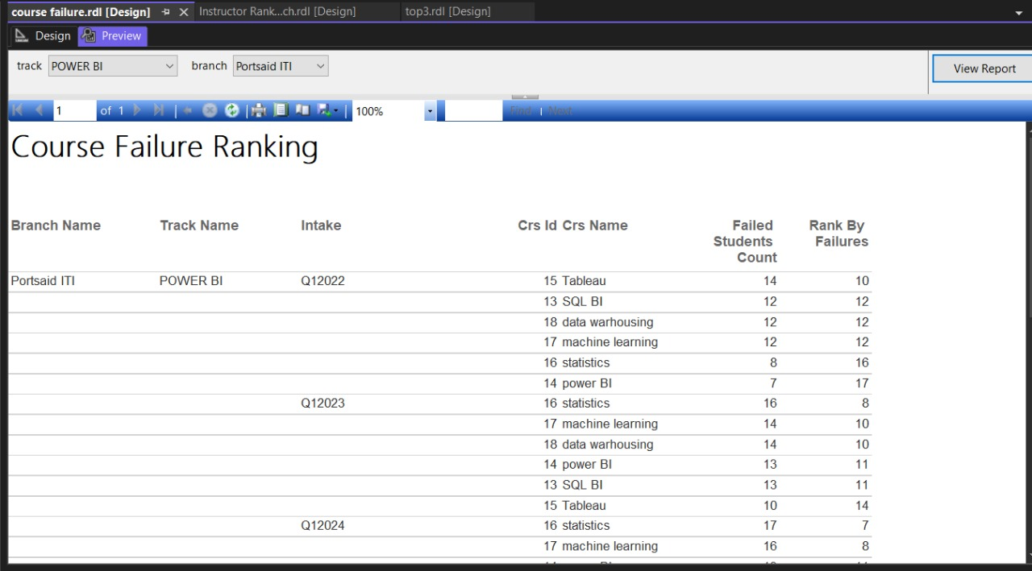

Slide 41
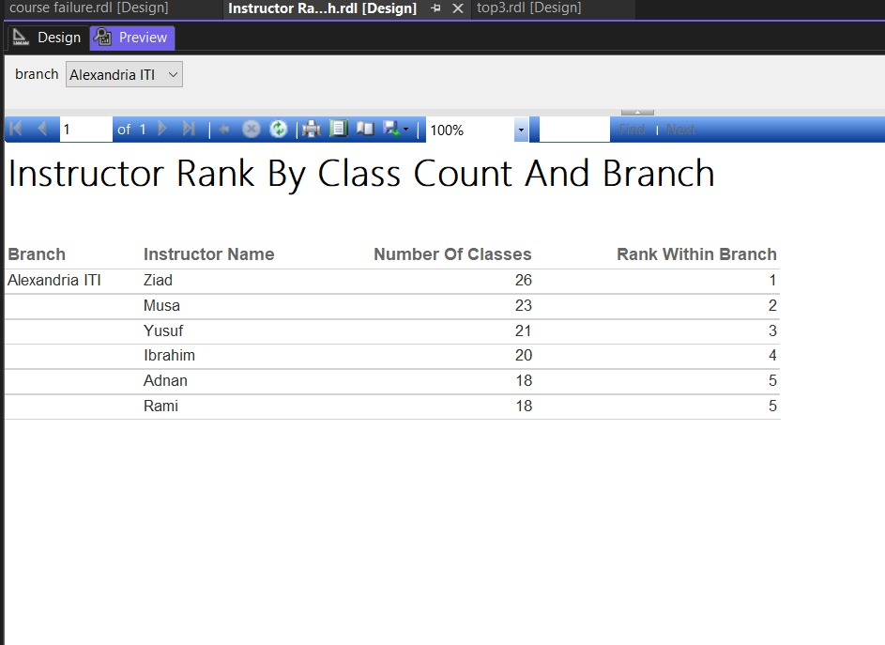

Slide 43
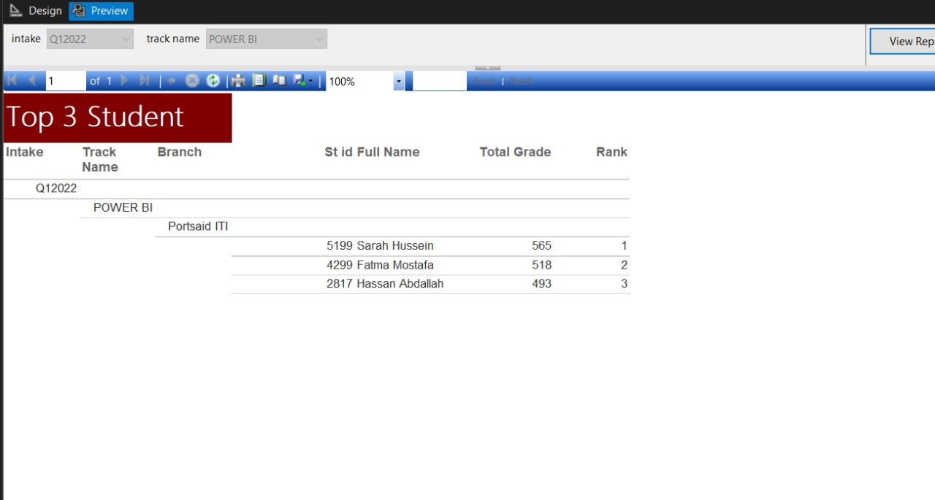

Slide 44
Dashboard

Slide 45

Home

Slide 46
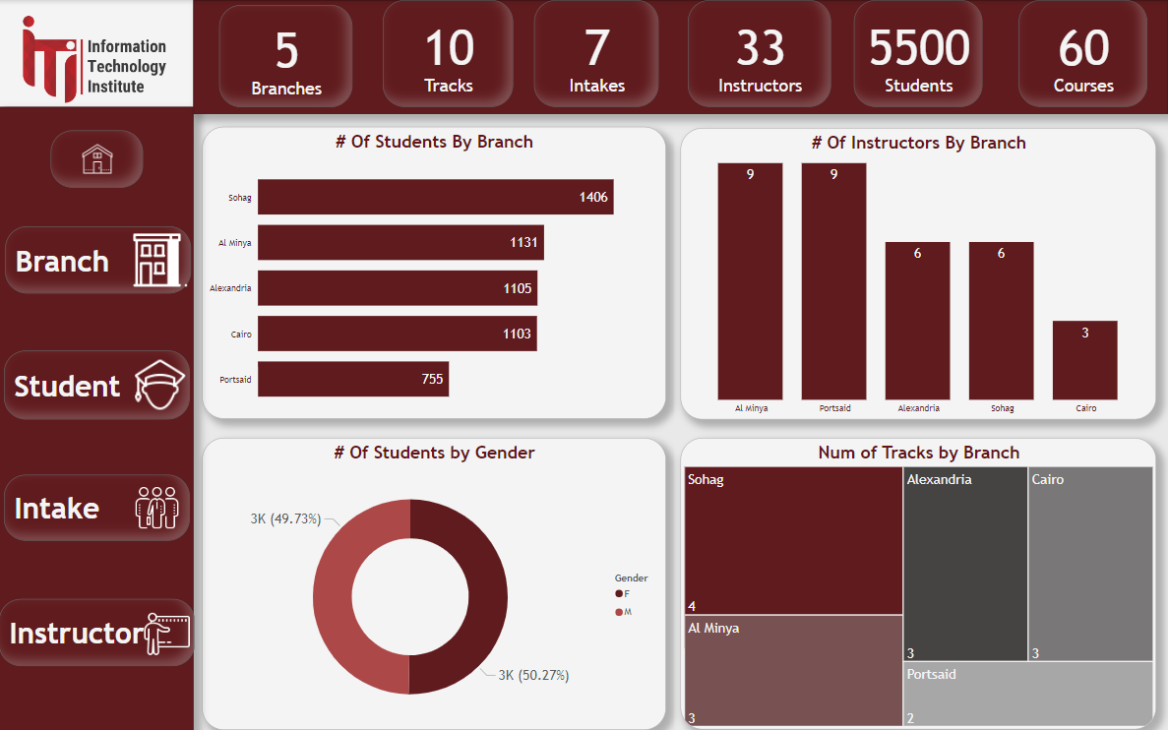
Overview

Slide 47
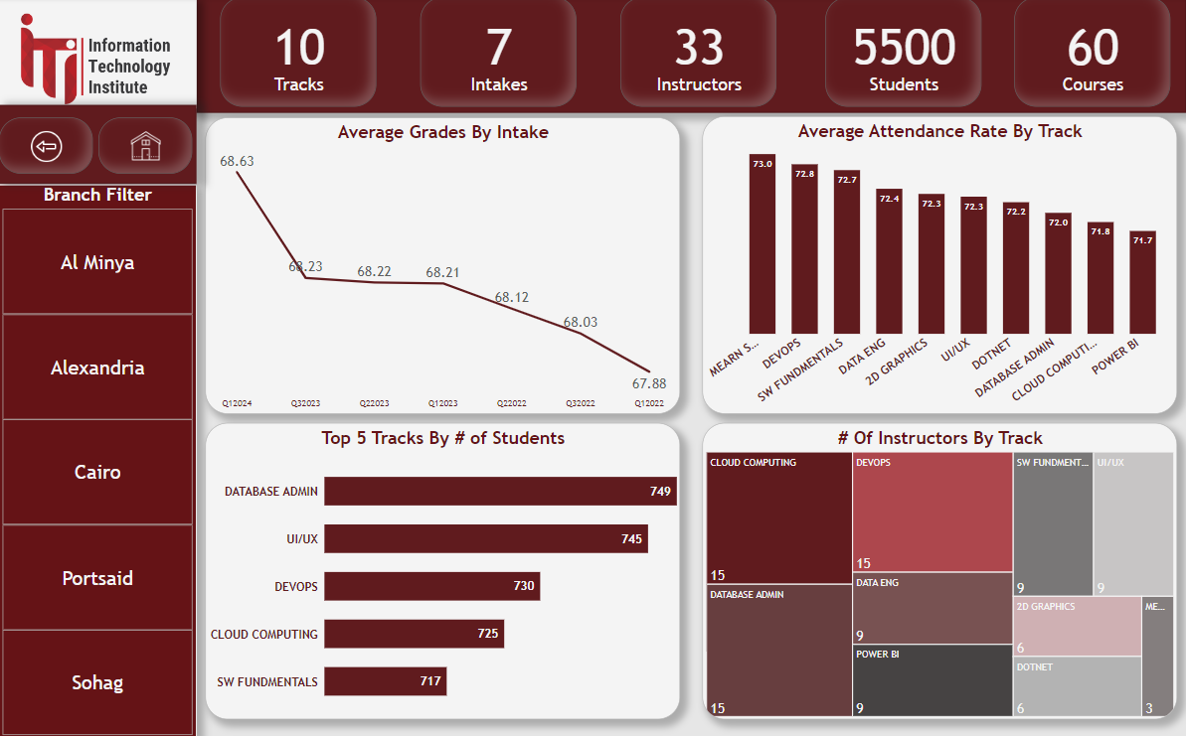
Branch

Slide 48
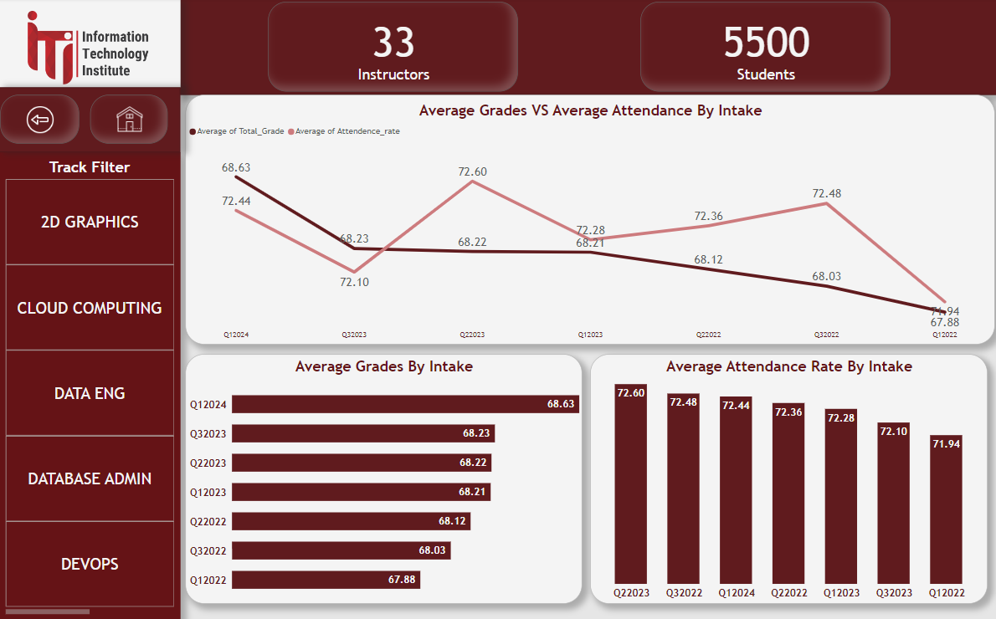
Intake

Slide 49
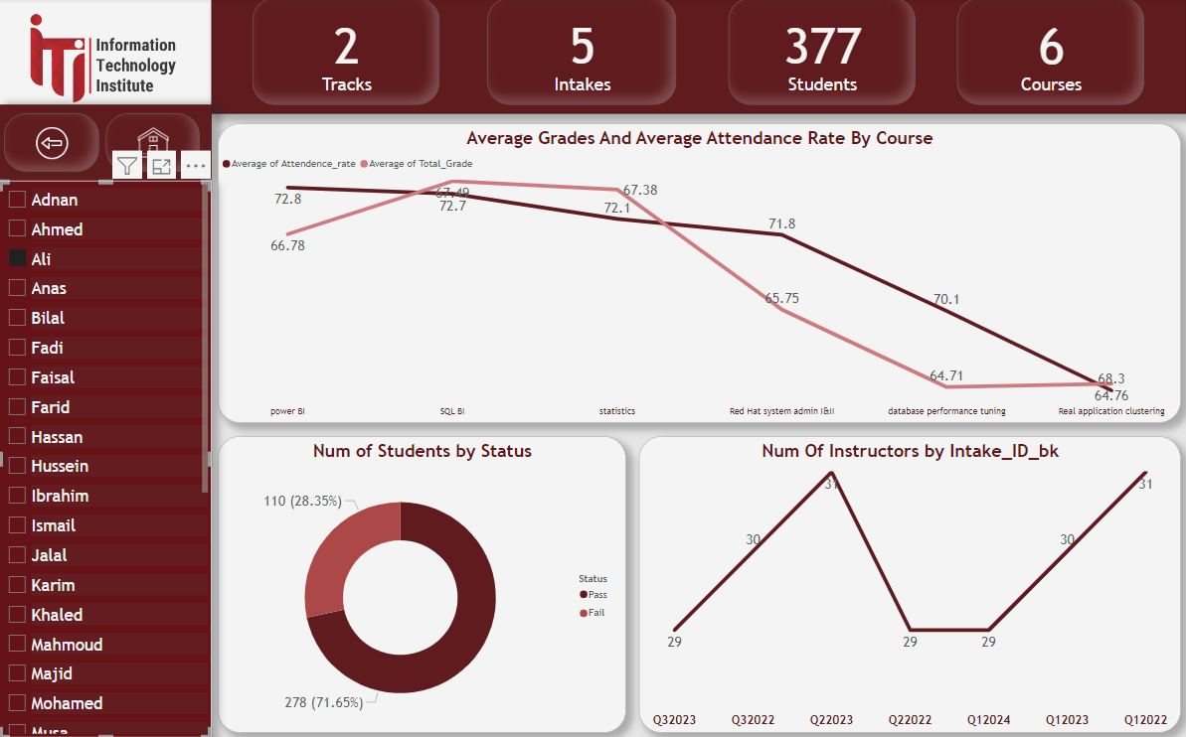
Instructor

Slide 50
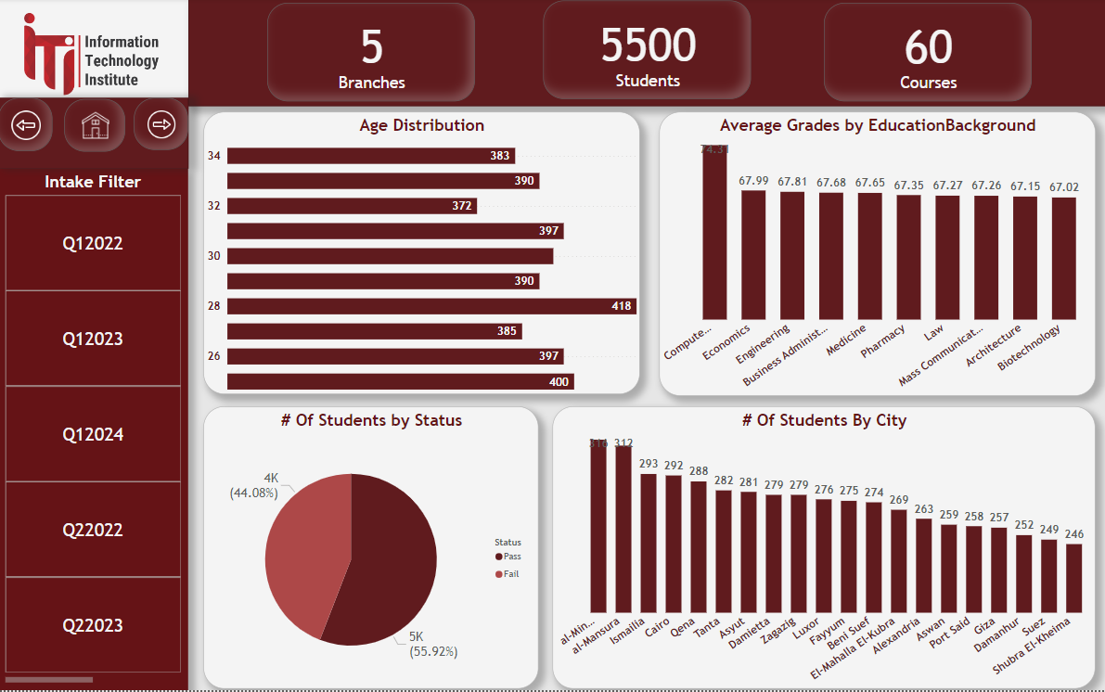
Student

Slide 51
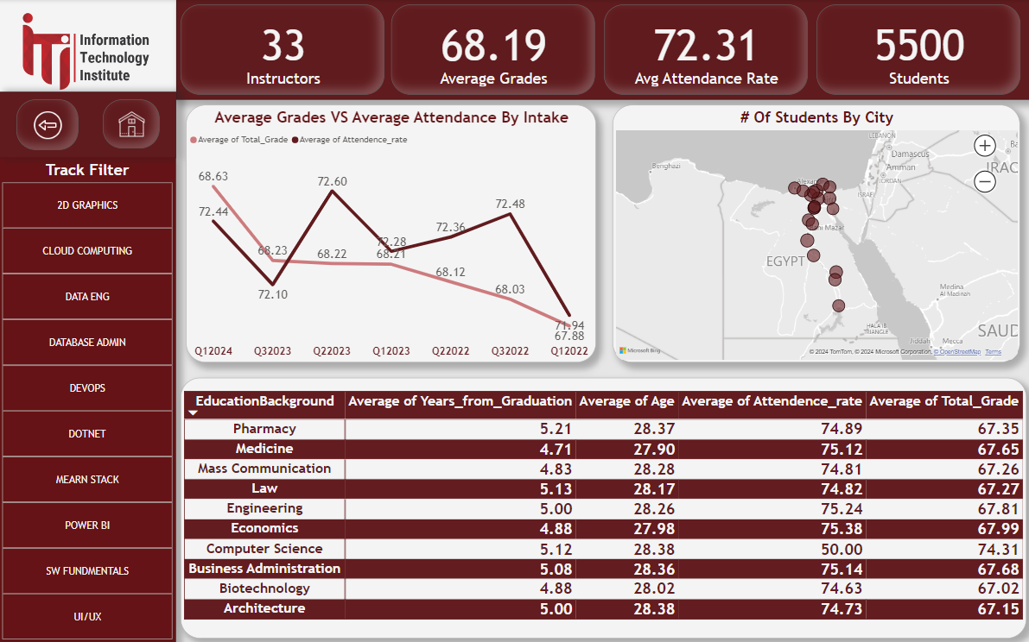
Student
Cont.

Slide 52
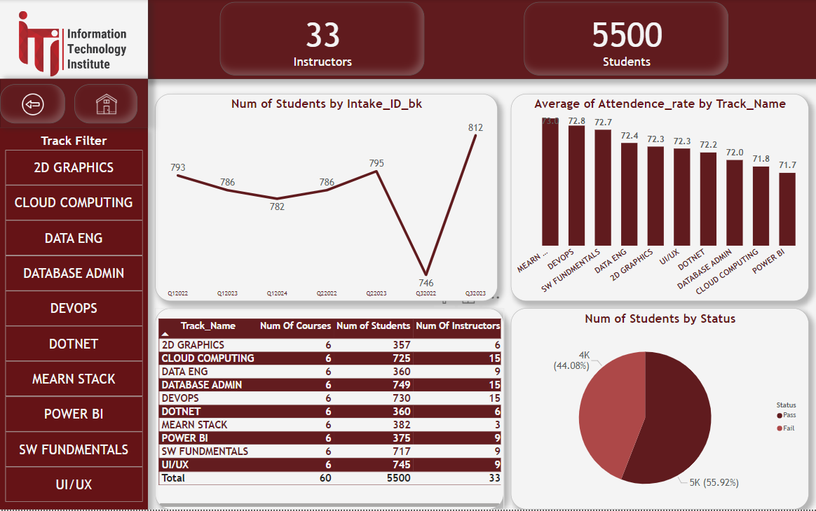
Track

Slide 53
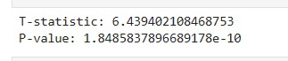

Slide 54
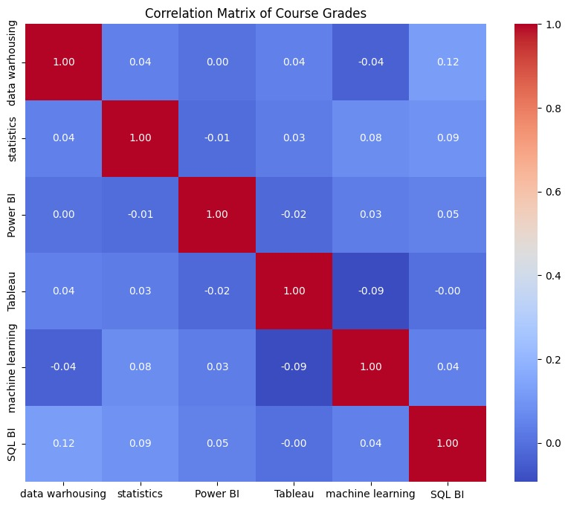

Slide 55
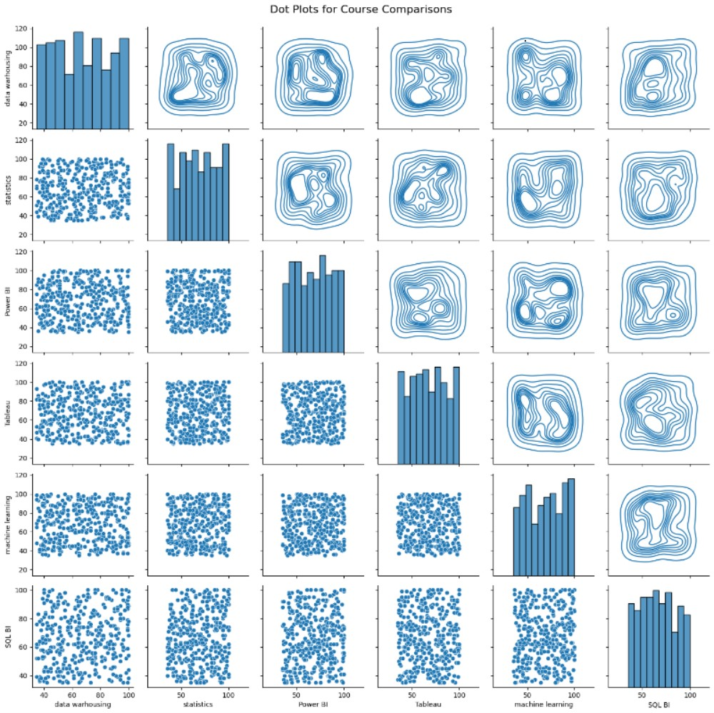

Slide 56
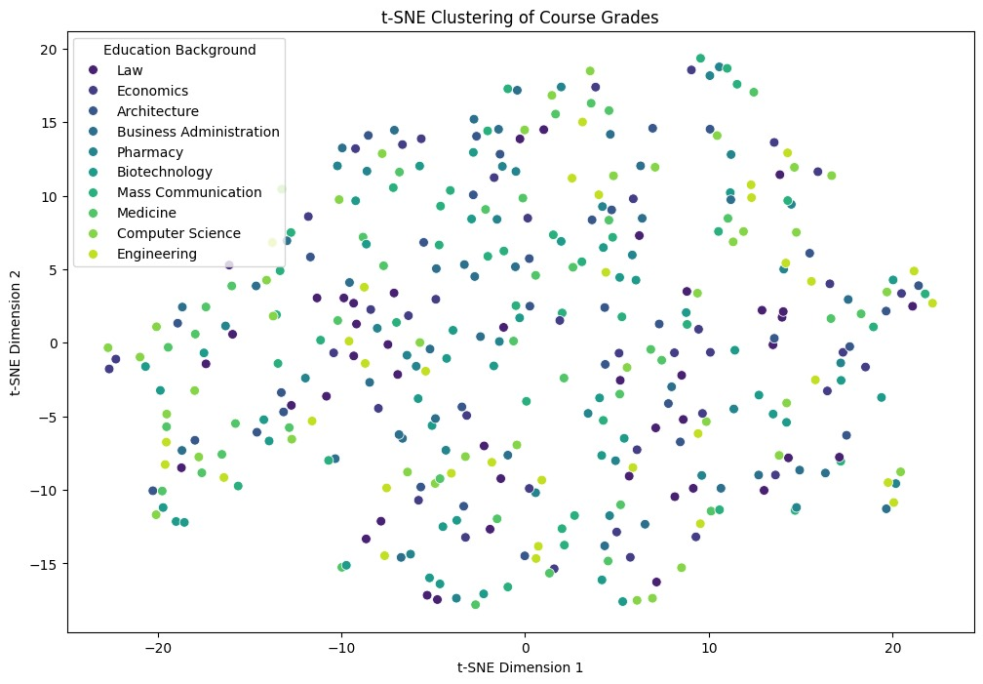

Slide 57
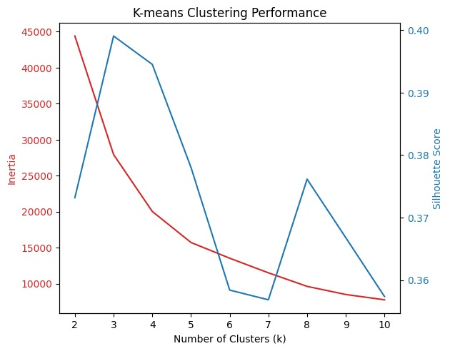

Slide 58
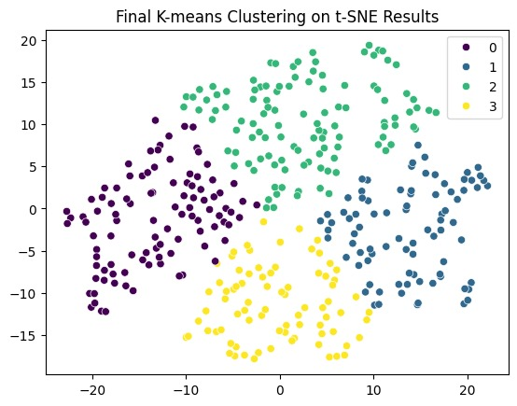

Slide 59
Thank You

